Slide 1

Introduction to Criminal e-Filing
Filing a Motion to an Existing Case
Franklin County Clerk of Courts

Slide 2
Topics for this Presentation
Helpful Technologies
How to File…
Filing A Motion to an Existing Case
How to check the Filing Status
Where to get Help

Slide 3
Helpful Technologies
A Scanner - with a recommended setting of 300 dpi
A PDF Converter – an online converter or ability to use the embedded PDF converter in Word
Online Adobe Word to PDF Converter
Note – Word Documents need to be in a .docx

Slide 4
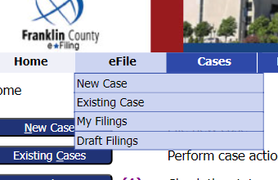
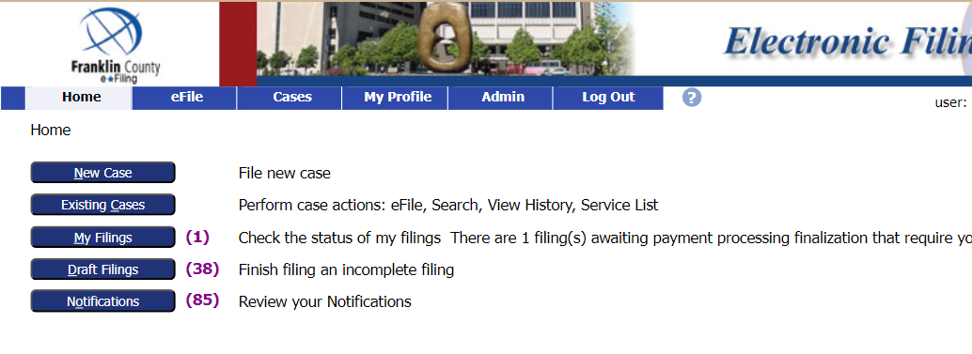
How to File a Motion to An Existing Case
Log into your e-Filing account.
Select File to an existing case from the
Existing Case Button on the left or
go to eFile tab, then choose Existing Case, from the dropdown menu

Slide 5
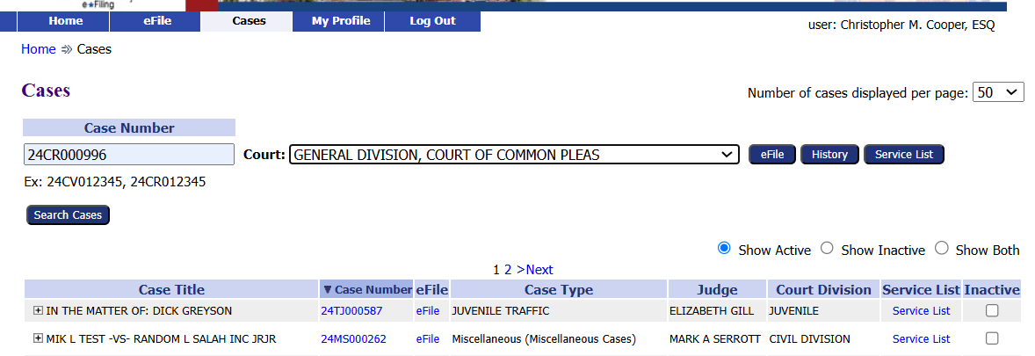
Filing a Criminal Motion
There are several options to search for a case.
Option 1
Enter the Case Number
Choose the court from the dropdown menu
Click the eFile button
Example case: 24CR000996

Slide 6
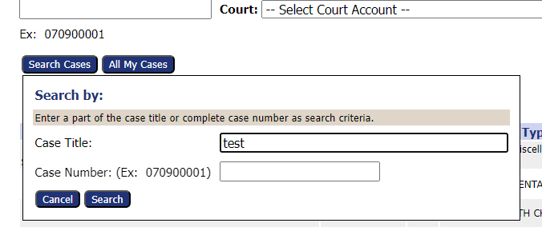
Filing a Criminal Motion
Option 2
Click the Search Cases button
Enter part of the Case Title or complete Case Number
Click the Search button
Example: 24CV003817

Slide 7
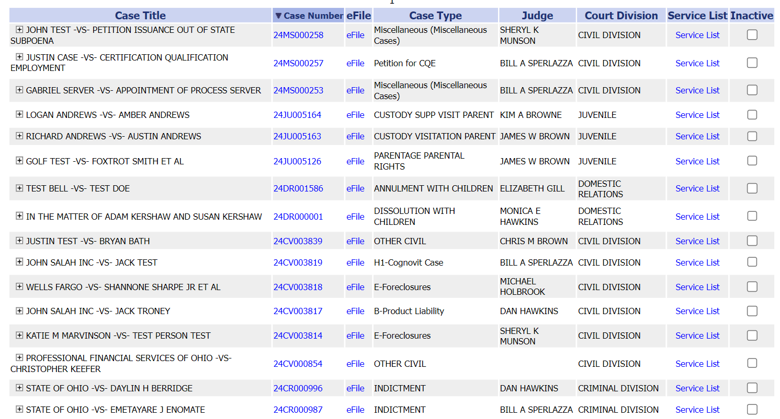
Filing a Criminal Motion
Option 3
Find the case from the list of cases.
Click the eFile link
Example: 24CR000996

Slide 8
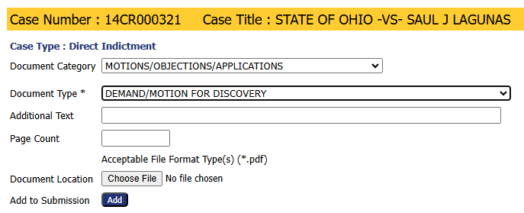
Choose a Document Category and Type
1. Choose a Document Category to filter the number of Document Type choices.
2. Choose a Document Type from the drop-down menu. This is a required field.

Slide 9
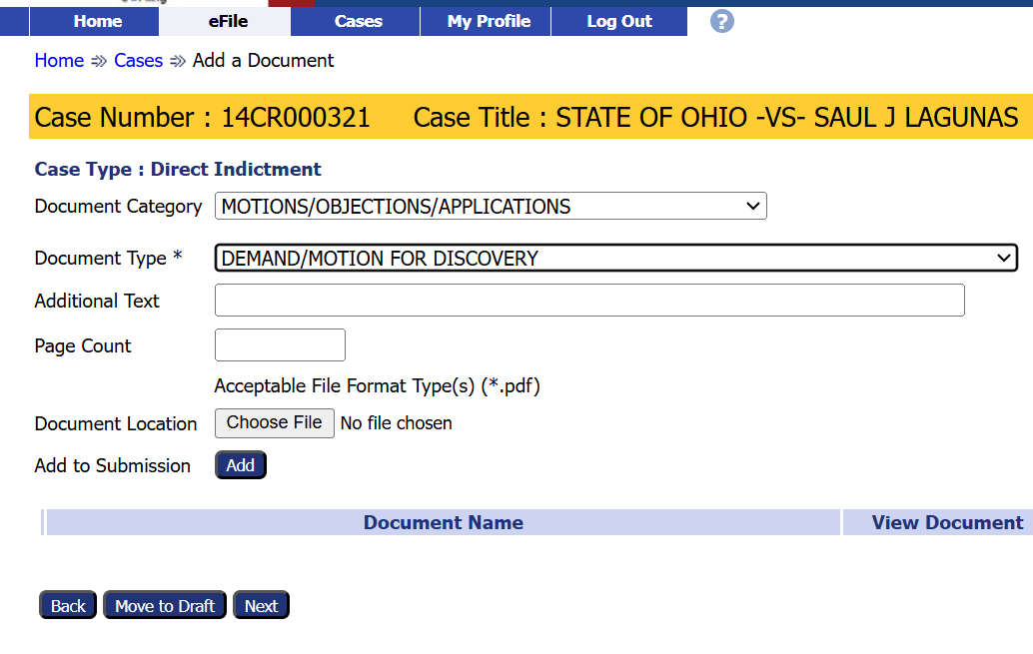
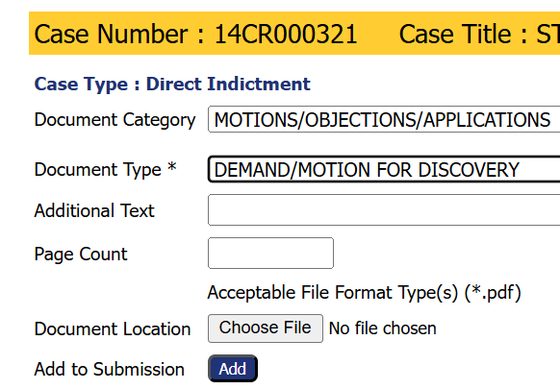
Add a Document
Note the required document format.
3. Click the Add button to add
the document to the filing.
2. Click the Choose File button to select and
upload a document.

Slide 10
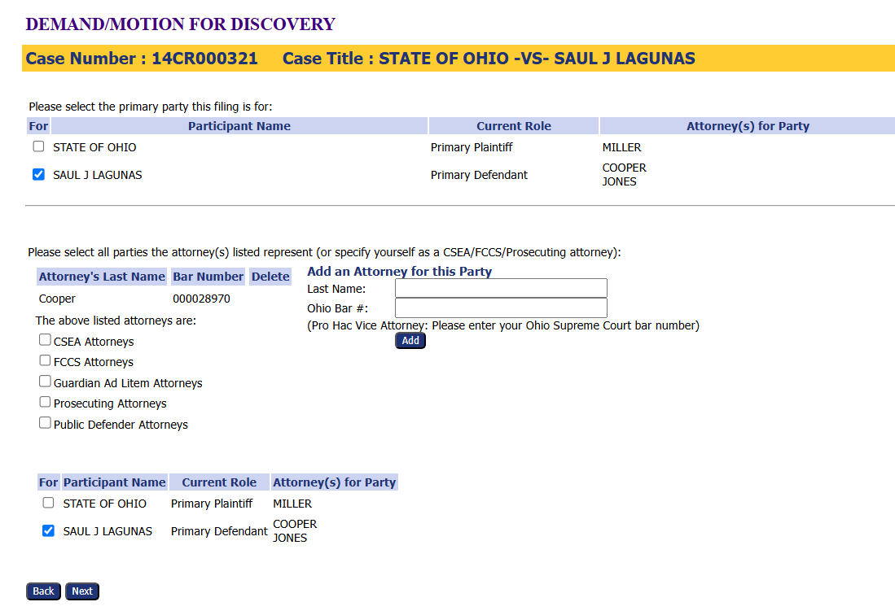
Select the Parties
1. Confirm the Participant’s name is already checked. In the top and bottom sections.
2. Confirm the attorney’s [yours] is in the middle section.
3. Add additional attorneys for the party, if needed.
4. Click the Next button.

Slide 11
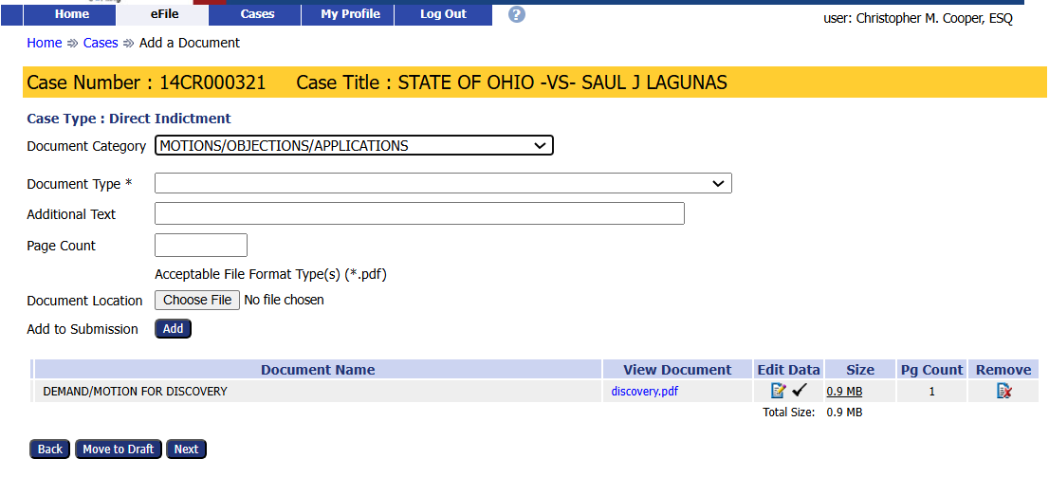
Add and/or Remove Documents
Add or remove documents before completing the filing process.
Select the Next button to continue with file submission even if no new documents are added.

Slide 12
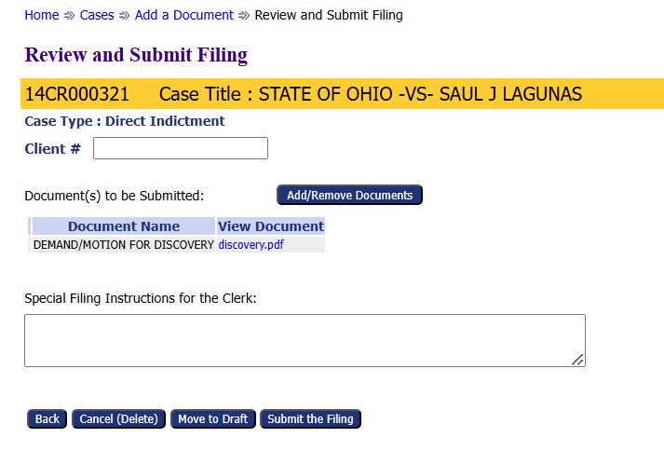
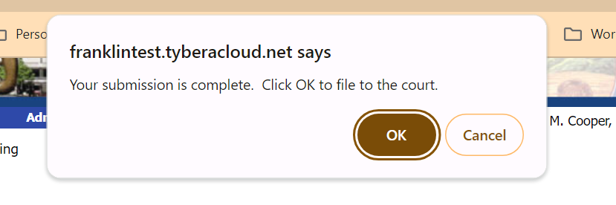
Submit the Filing
Use the optional Client # field to enter an office case reference number.
Add or Remove additional documents, if needed.
Add any filing notes
Other options
Cancel (Delete) the filing
Move to Draft – Save the filing to be completed later.
Submit the Filing – completes the filing process.

Slide 13
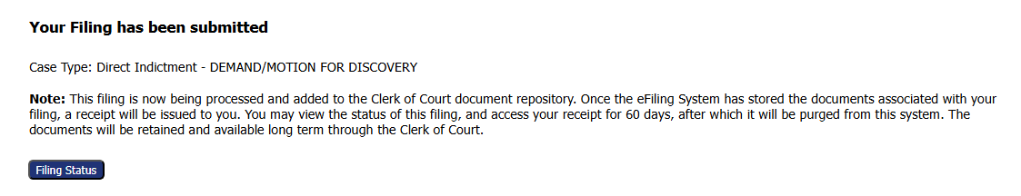
Submission Confirmation
A confirmation of submission will appear.
Click on the Filing Status to check where the case is in the approval process.
*Note- Filed references that the filing has been accepted.

Slide 14
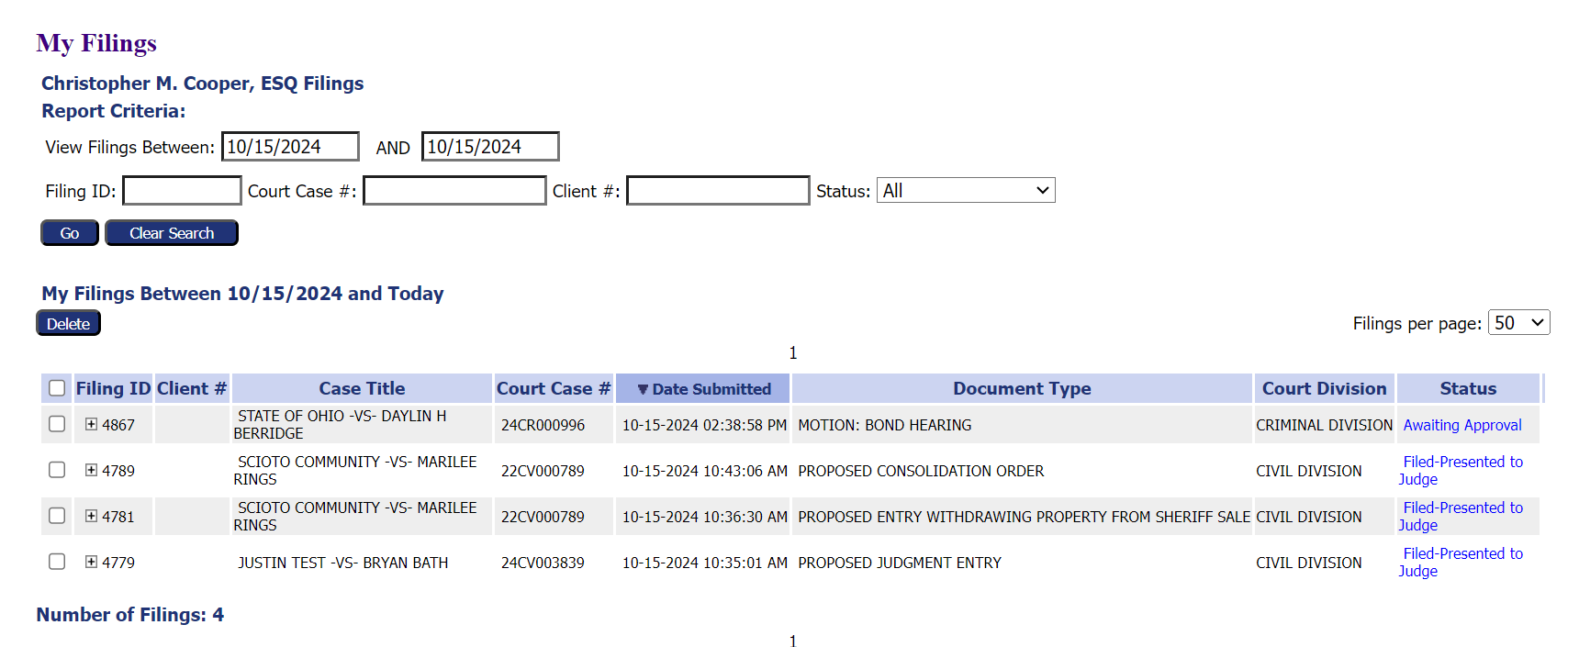
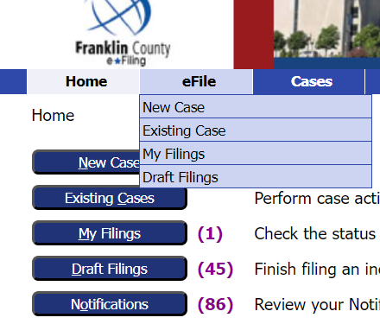
Filing Status
Clicking the Filing Status button brings up a list of all filed cases and their status.
Users can search for a specific case on this page.
This page can be reached by clicking My Filings from the Home page
or by going to the eFile tab and selecting My Filings from the drop-down menu.

Slide 15
Thank you for using the
Franklin County e-Filing System
franklincountyclerk@franklincountyohio.gov

