Slide 1

Introduction to e-Filing
Filing a New Civil Case

Slide 2
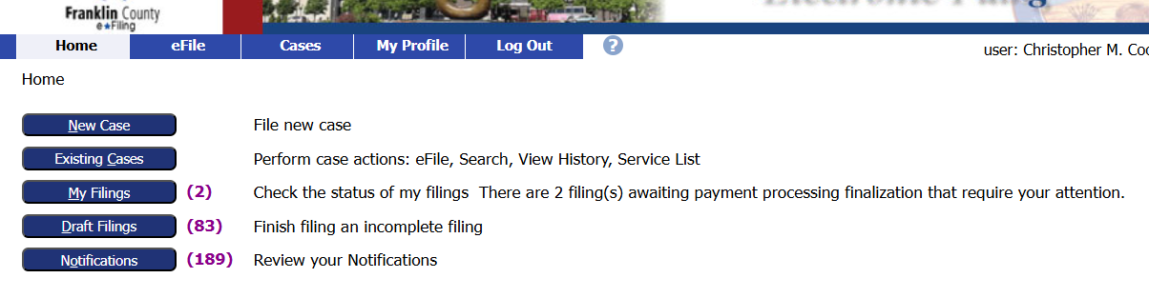
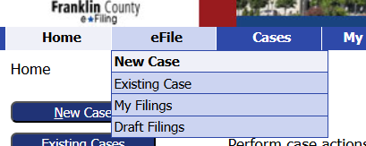
File a New Civil Case
From the Home screen, click on the New Case button.
Or go to the eFile tab and select New Case from the dropdown menu.

Slide 3
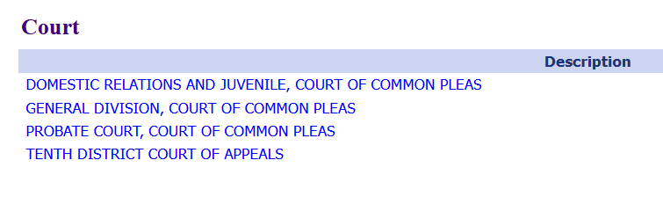
File a New Civil Case
Click on the General Division, Court of Common Pleas link.

Slide 4
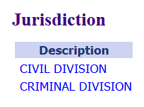
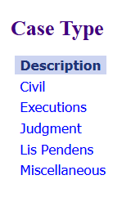
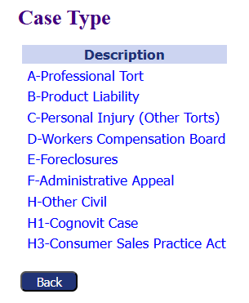
File a New Civil Case
Select Civil Division.
Select Civil.
Choose the appropriate Case Type.

Slide 5
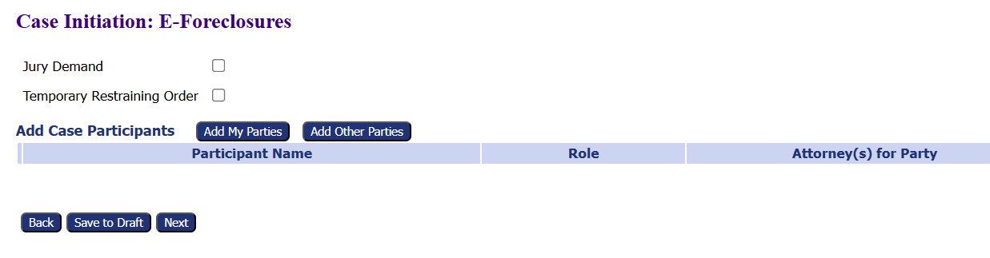
Select the Add My Parties button to add case participants.
File a New Civil Case

Slide 6
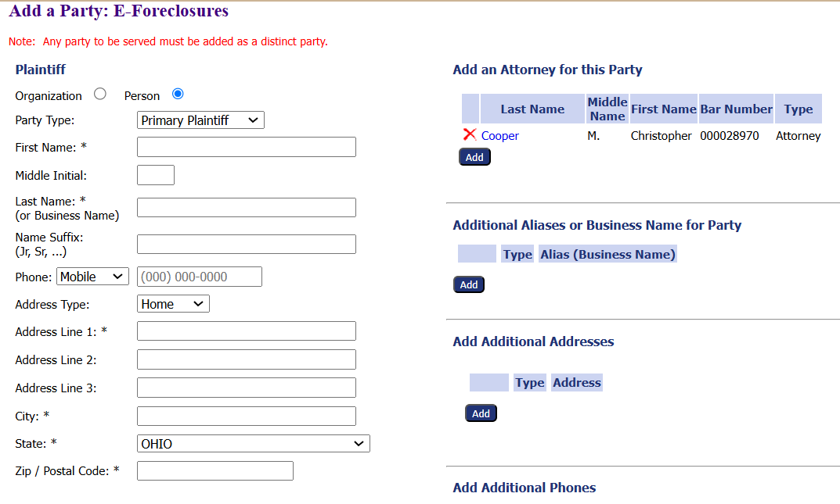
Complete the Plaintiff’s contact information.
The starred fields are required.
Add Additional
Attorneys
Aliases or Business Names for Party
Addresses
Phones
File a New Civil Case

Slide 7
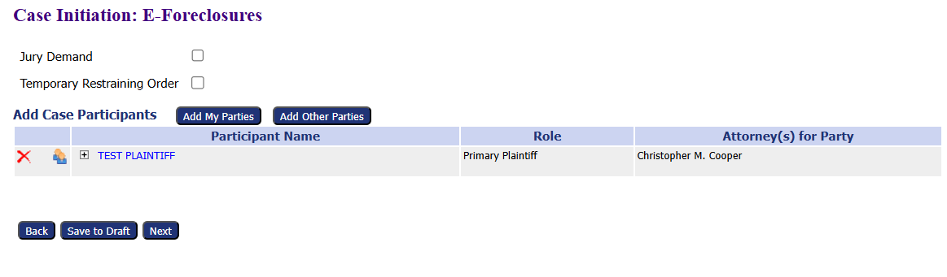
File a New Civil Case
Company Name should be your organization.
Click Add Other Parties to add the defendant.

Slide 8
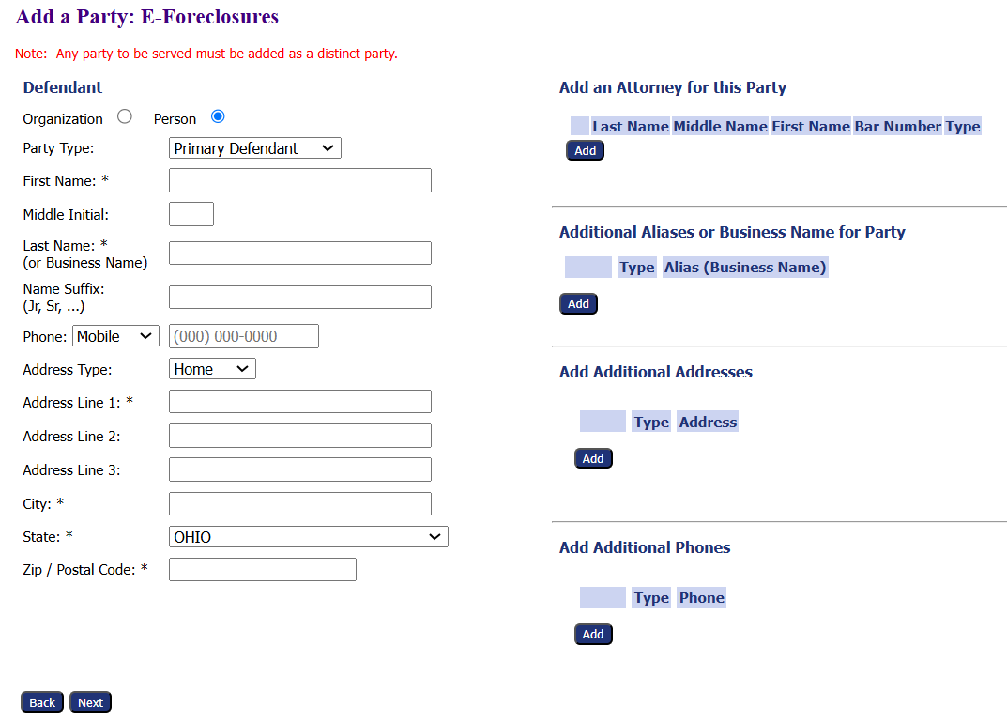
Complete the Defendant’s contact information.
The starred fields are required.
Add Additional
Attorneys
Aliases or Business Names for Party
Addresses
Phones
File a New Civil Case

Slide 9
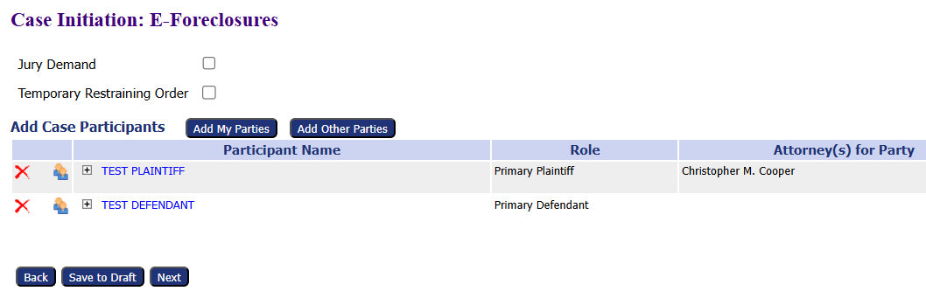
File a New Civil Case
Confirm the information is correct and add any additional parties such as a secondary defendant, if necessary.

Slide 10
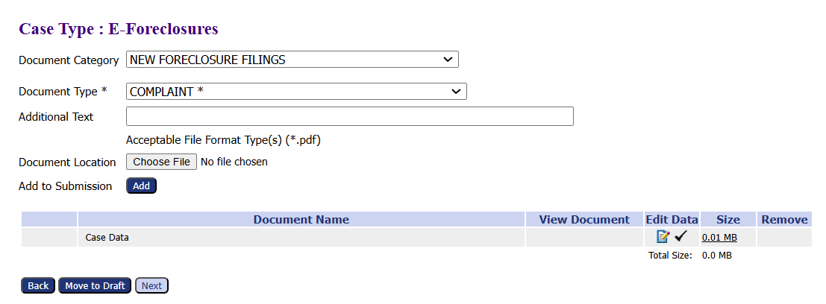
File a New Civil Case
Choose a Document Category from the dropdown menu to filter the document types.
Choose a Document Type from the dropdown menu. Document Type is a required field. A Complaint for new case filing should be chosen.
Click Choose File to upload the document for the complaint. *Note the file type for the document. In this case, it is a PDF.
Click the Add button to add the file to the case.
Click the Next button to add the file to the case.

Slide 11
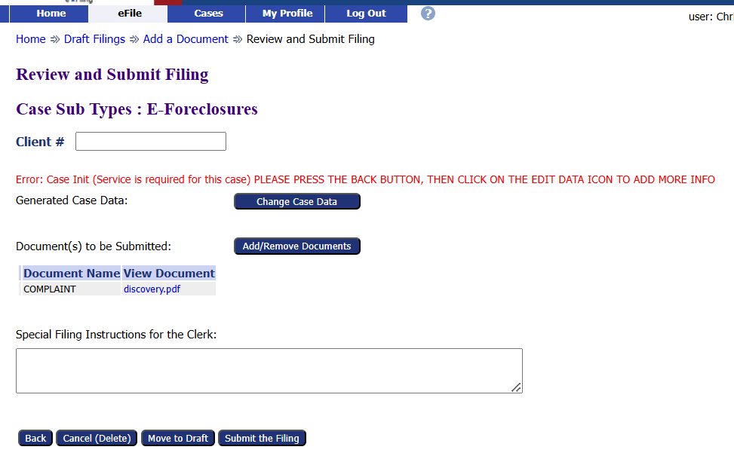
File a New Civil Case
*Some case types require a Service be added to the case.
If you receive the message in red on the next screen, click the Back button to return to the Add Documents screen.

Slide 12
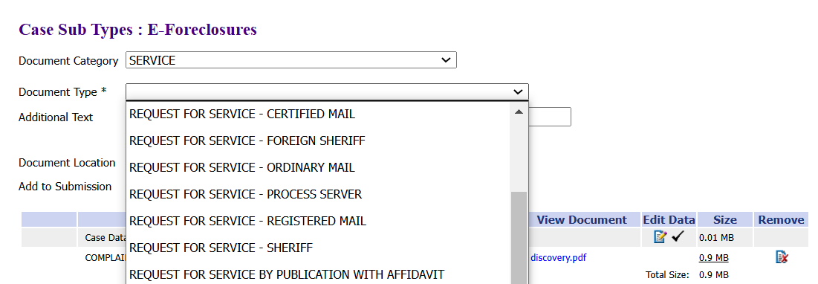
File a New Civil Case
Choose Service from the Document Category dropdown menu to filter the document types.
Choose which service you need from the Document Type dropdown menu.
The service document is a generaform with no upload form. Just click Add to add it to the filing.

Slide 13
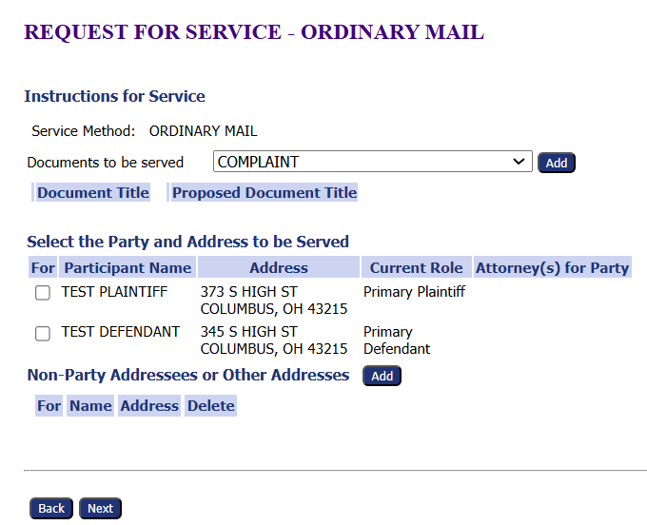
File a New Civil Case
Choose the Documents to be served from the dropdown menu. Click Add.
Select the parties that will receive the service.
Click Next.

Slide 14
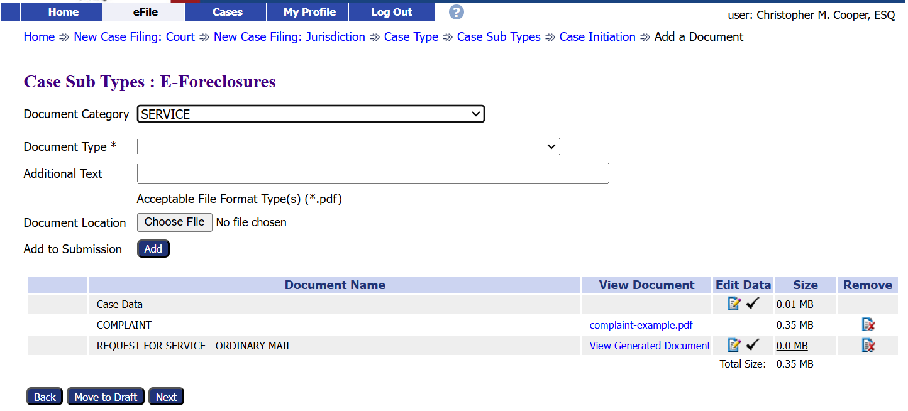
File a New Civil Case
Confirm all documents listed are correct.
Add or remove documents, if necessary.
Click Next.

Slide 15
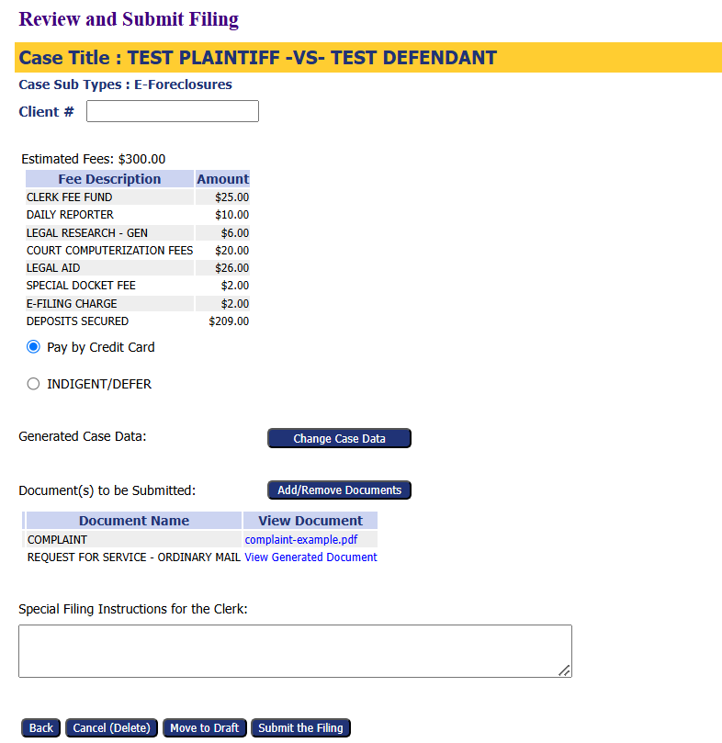
File a New Civil Case
Review case information before submitting the filing.
An optional Client # field is available to add an office reference number.
Update the filing by clicking the Change Case Filing button, if necessary.
Add/Remove documents, if necessary.
Click Submit the Filing to move to the next step of the process.

Slide 16
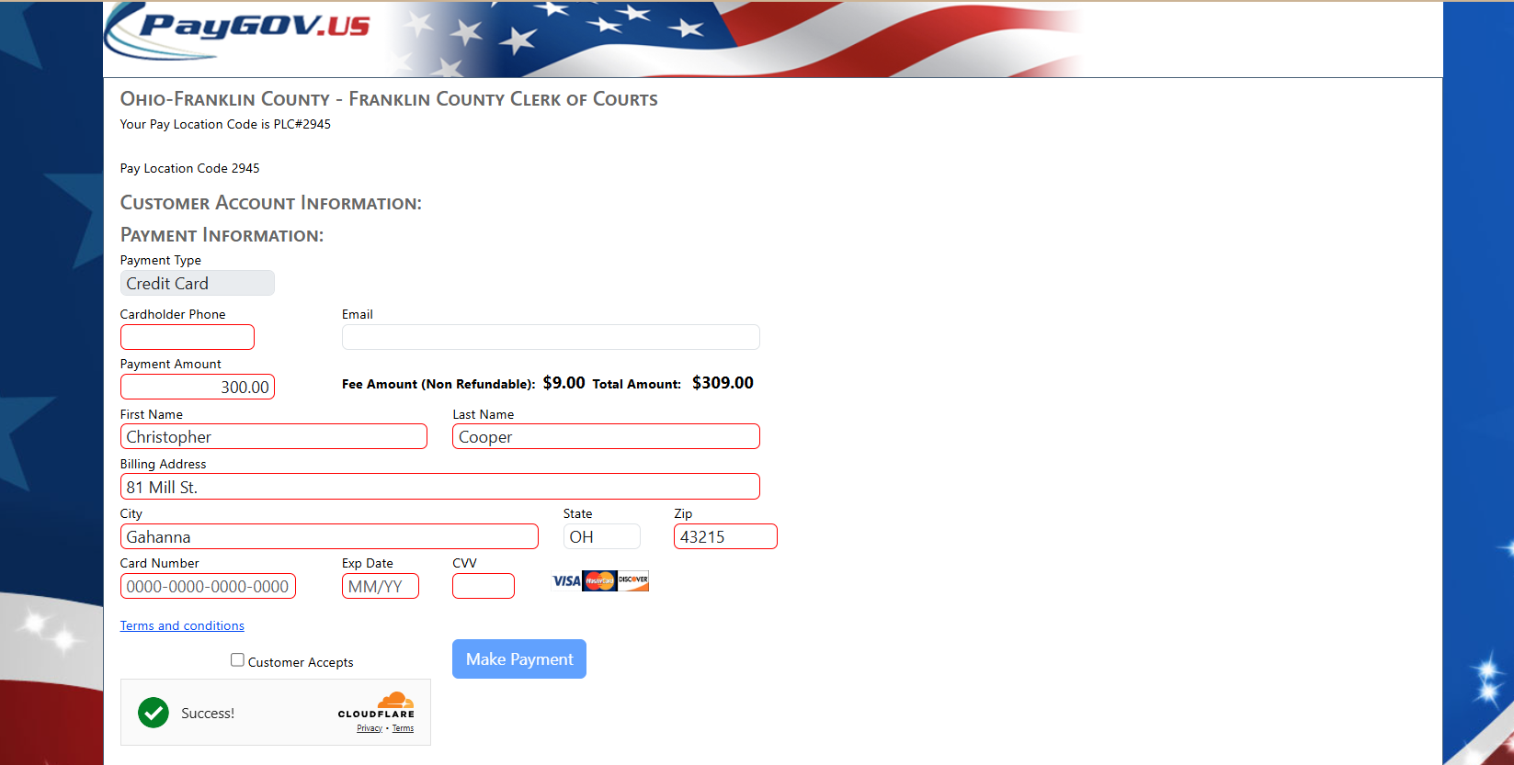
File a New Civil Case
You are taken to the PayGov.US website to pay any filing fees.
Enter the payment information.
Accept the Terms and Conditions by checking the Customer Accepts box.
Verify the Captcha by checking the Cloudflare box.
Click the Make Payment button to submit the payment.

Slide 17
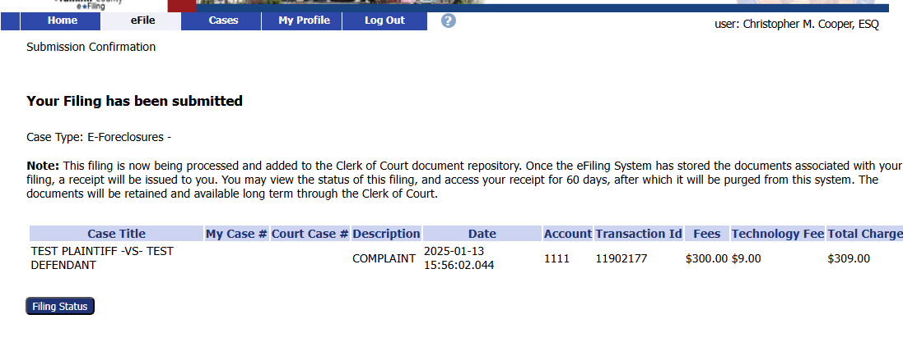
File a New Civil Case
You are returned to your e-Filing account after payment.
Click the Filing Status button to view where your filing is in the approval process.

Slide 18
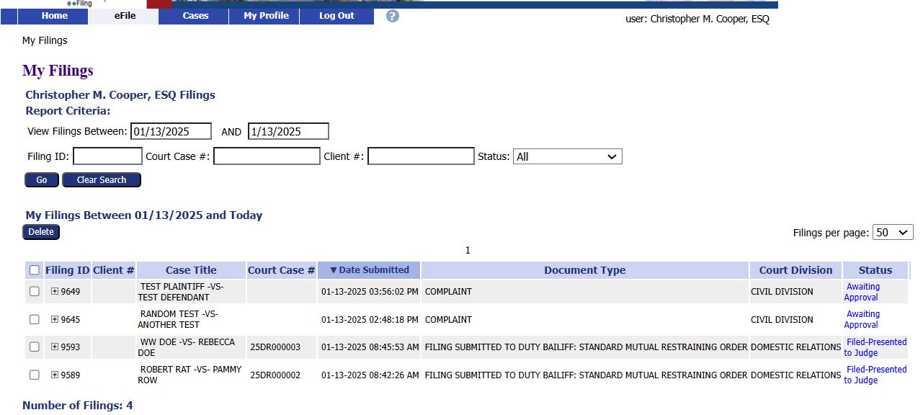
File a New Civil Case
Clicking the Filing Status button brings up a list of all filed cases and their status.
Users can search for a specific case on this page.

Slide 19
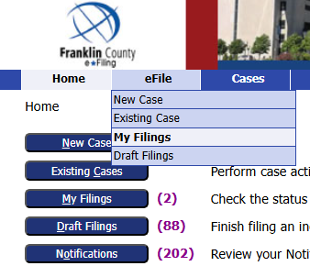
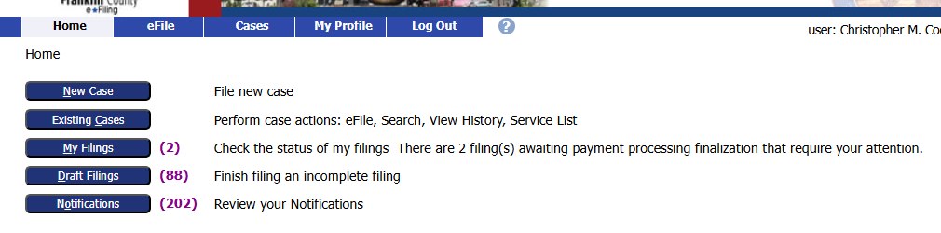
File a New Civil Case
The filings status page can be reached by clicking My Filings from the Home page
or by going to the eFile tab and selecting My Filings from the drop-down menu.

Slide 20
Thank you for using the
Franklin County e-Filing System
For help or questions about e-filing, contact the Clerk of Courts Office by email at franklincountyclerk@franklincountyohio.gov.

